Slide 1
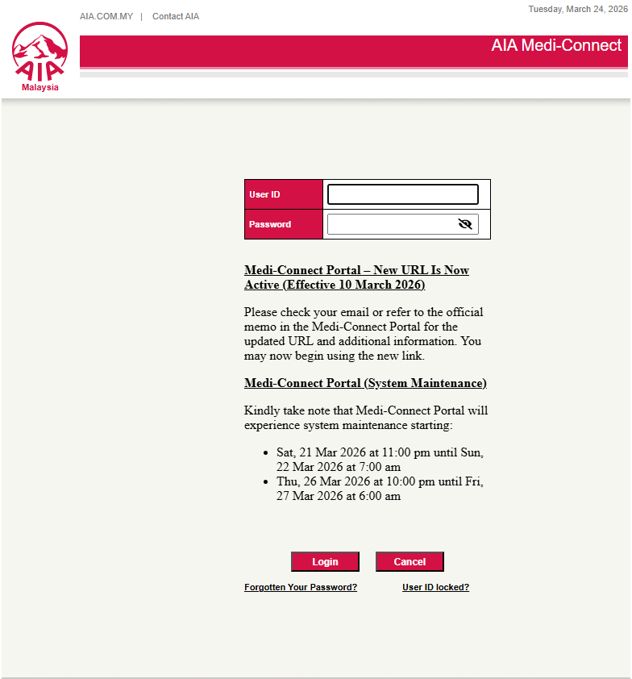
Download AIA Panel Payment
First, log into your AIA panel portal

Slide 2
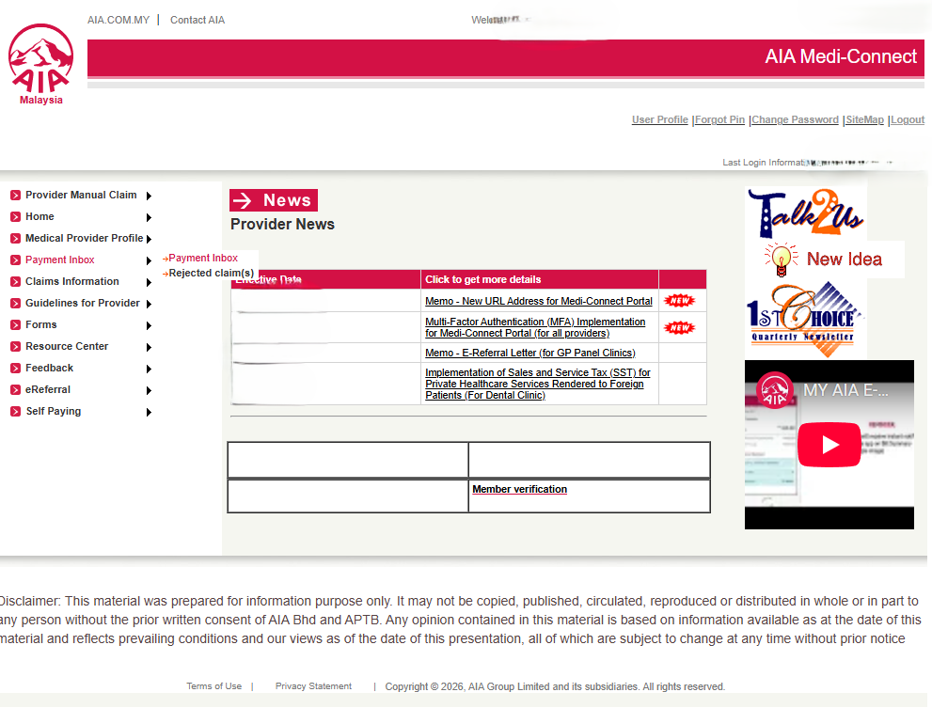
Payment Inbox
Next, go to Payment Inbox
Insert PIN and go back to Payment Inbox

Slide 3
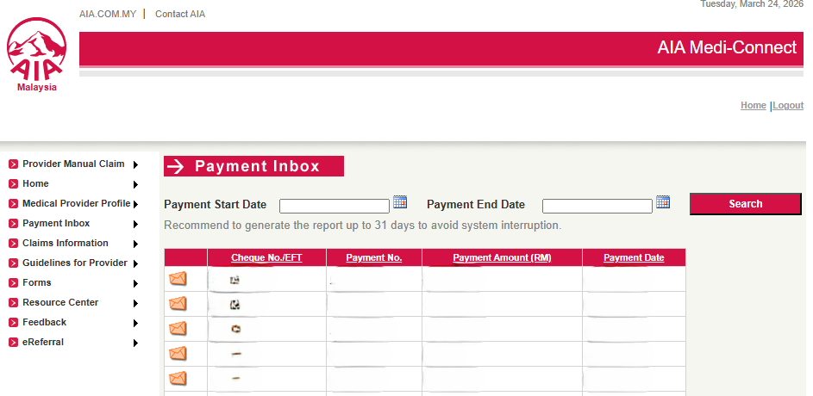
Payment No
Next, select the Payment No which you want to reconcile with your electronic medical record

Slide 4
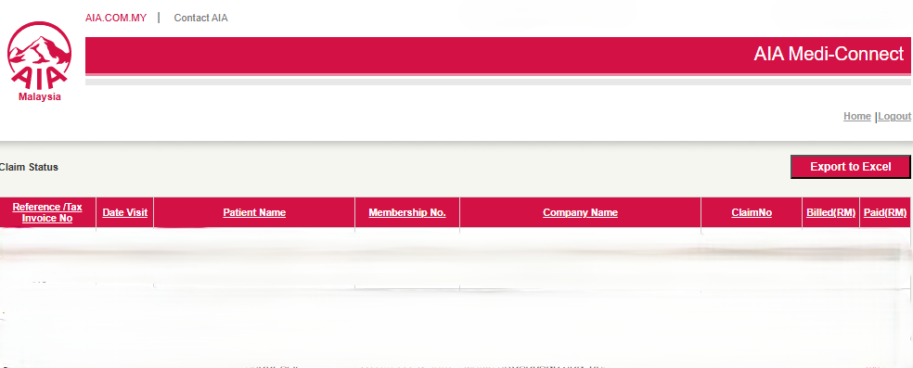
Export to Excel
Next, download the AIA panel payment file by clicking on Export to Excel
Save the file to be used for ClaimHub reconciliation

