Slide 1
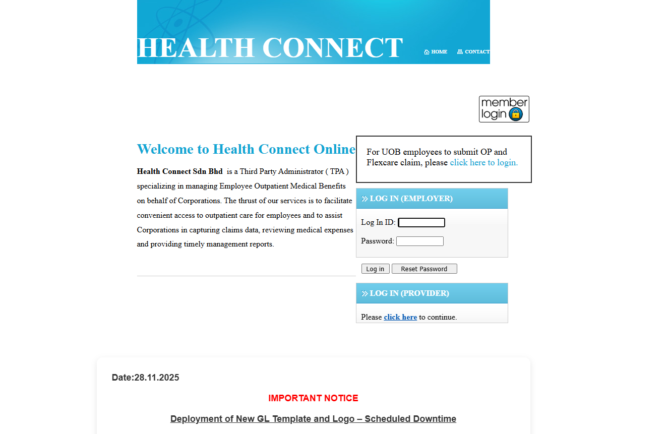
Login
Login to Health Connect at Provider

Slide 2
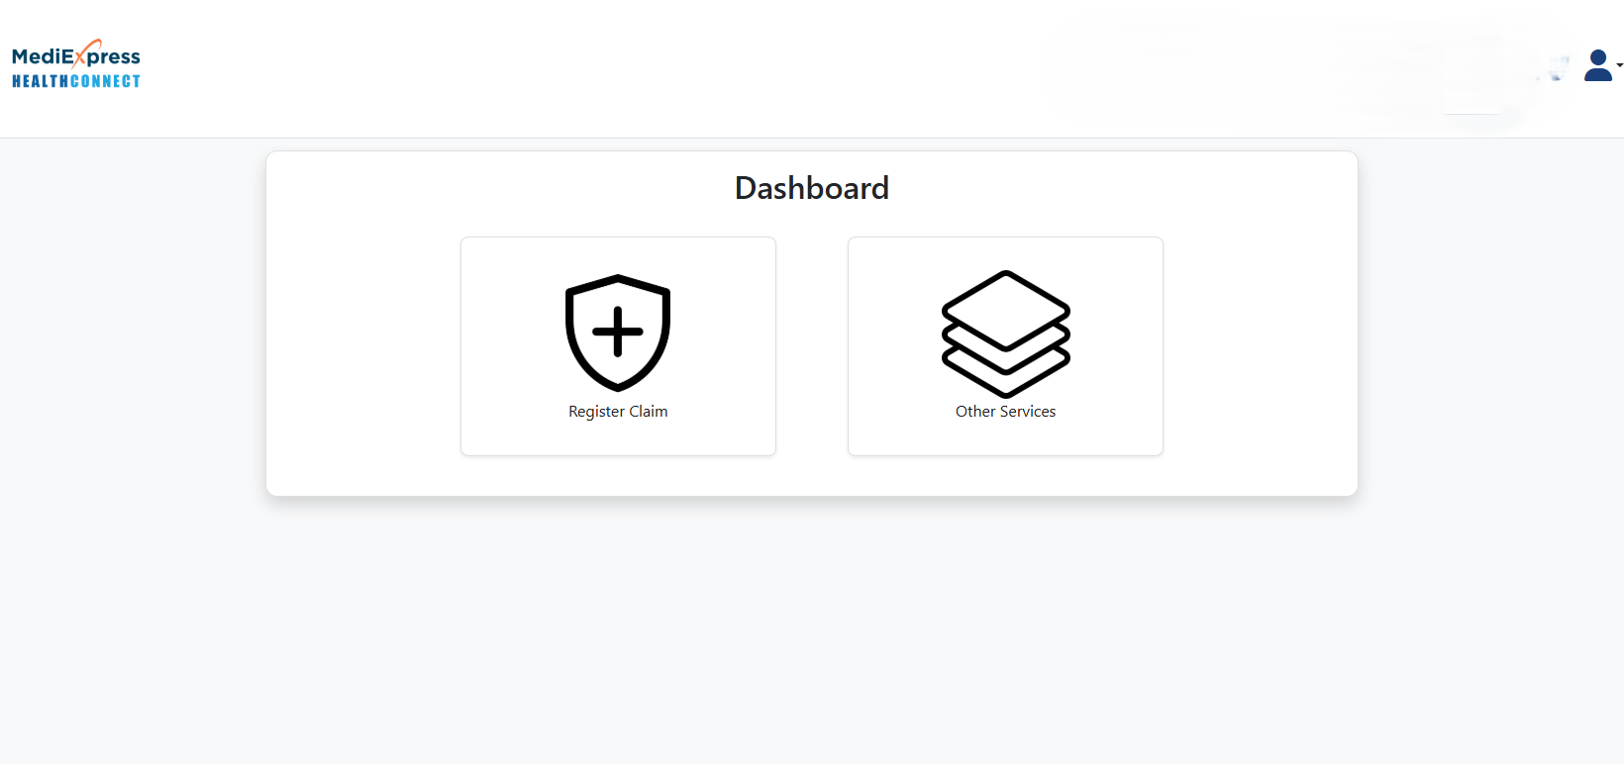
Other Services
Click on Other Services

Slide 3
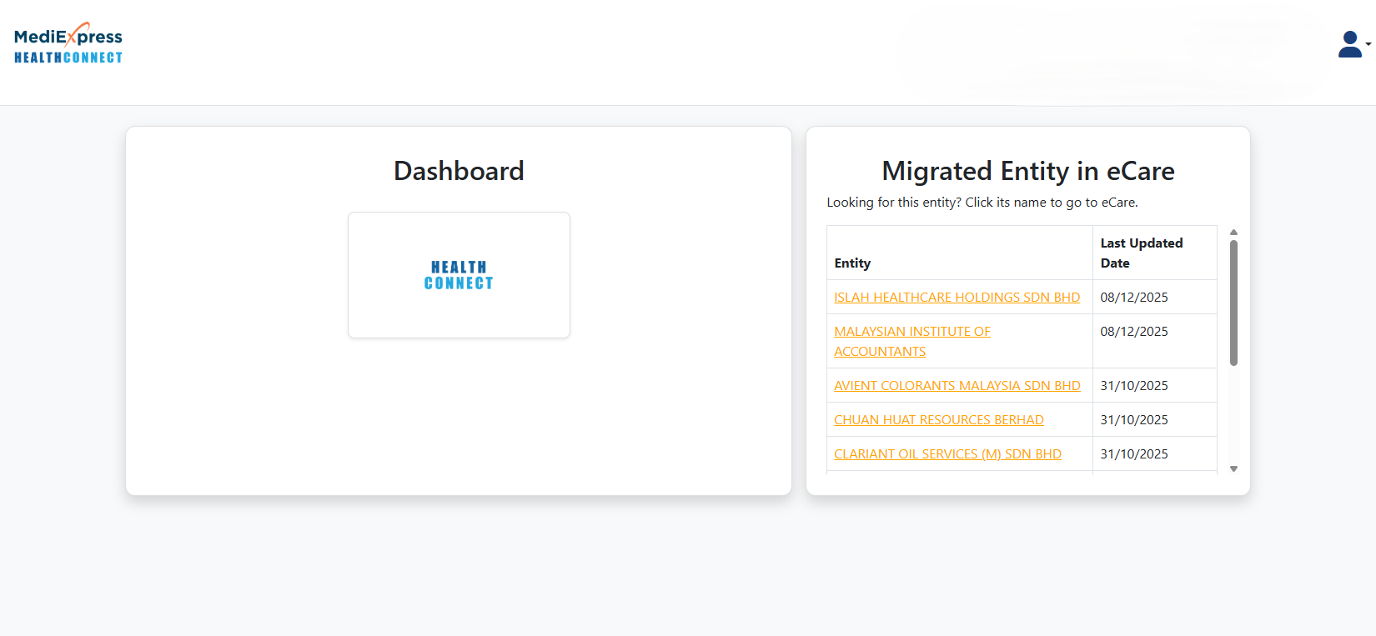
Dashboard
Click on Health Connect logo at Dashboard

Slide 4
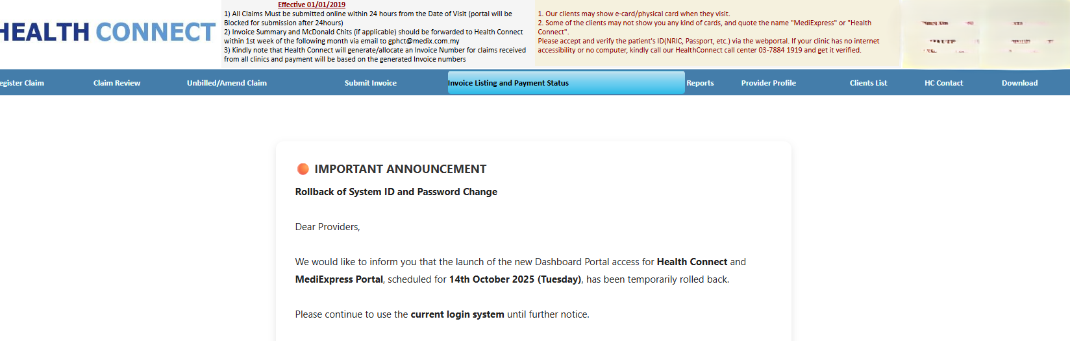
Invoice Listing and Payment Status
Click on Invoice Listing and Payment Status

Slide 5
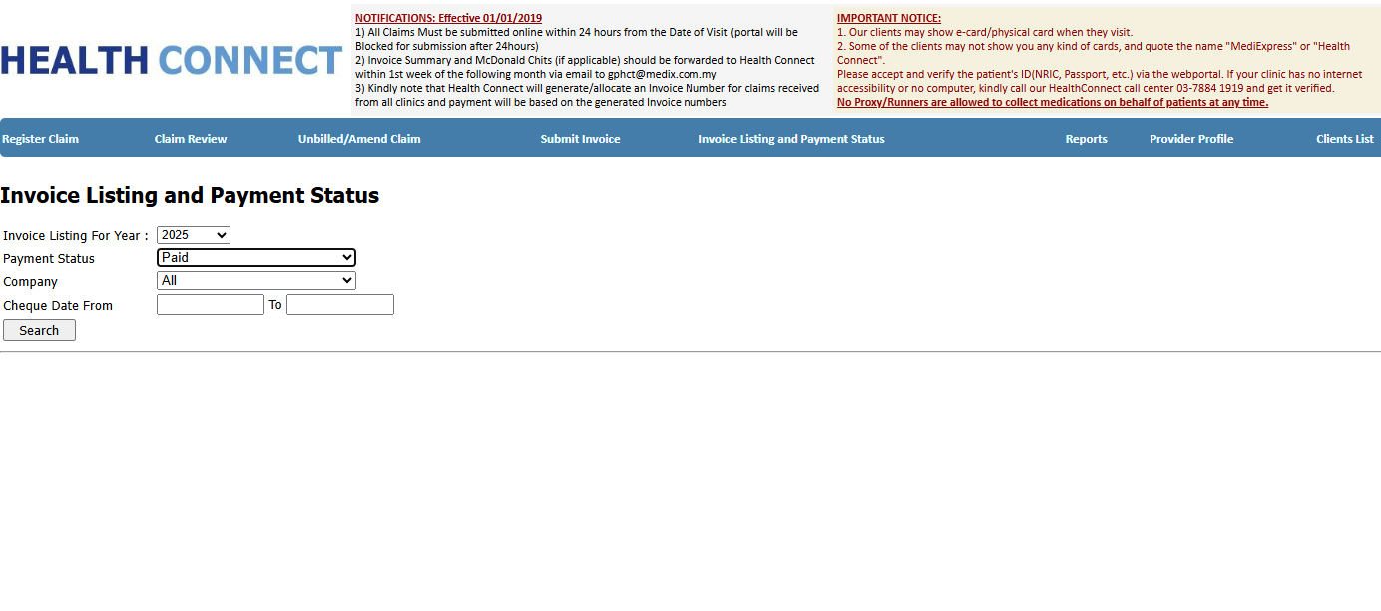
Year and Payment Status
Change the Invoice Listing for Year
Change Payment Status to Paid

Slide 6
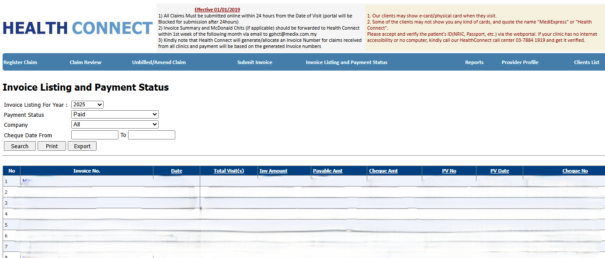
Invoice No
Click on appropriate Invoice No

Slide 7
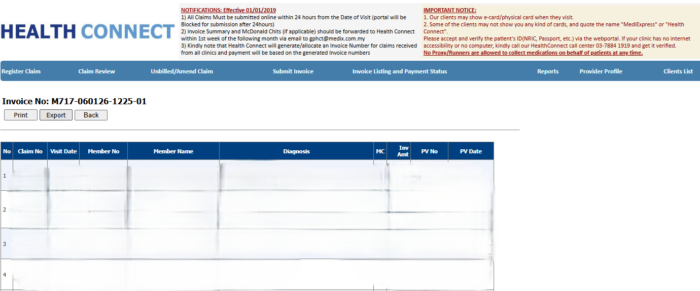
Export
Click on Export

Slide 8
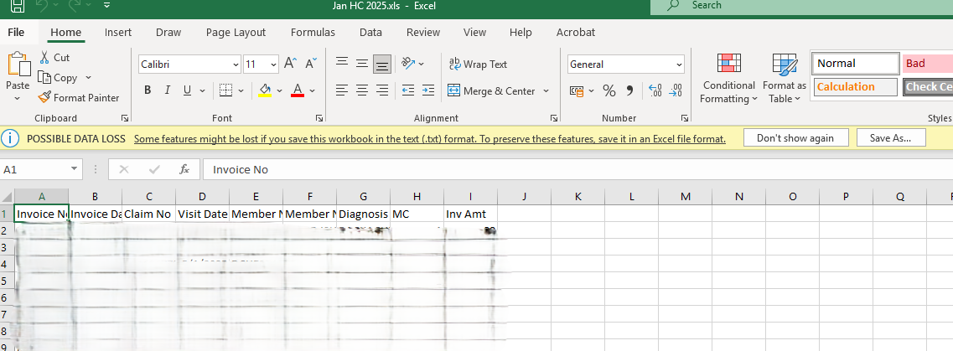
Save .xls into .xlsx
Open the file
Go to File at top left corner

Slide 9
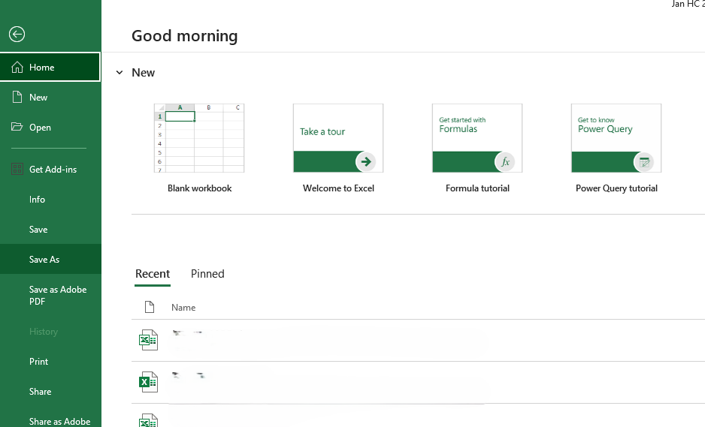
Save as
Click Save As

Slide 10
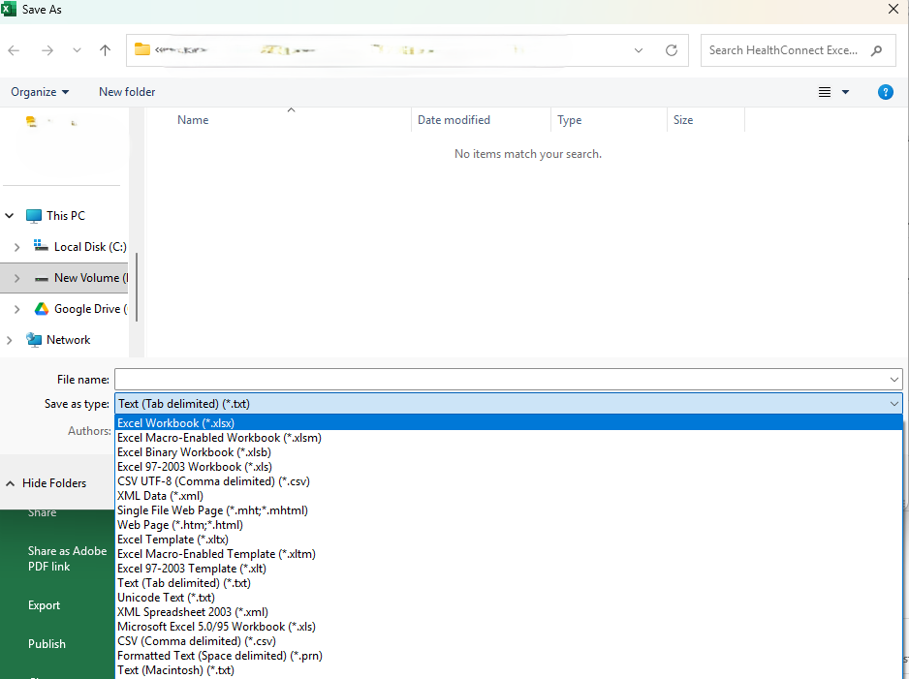
Save as Excel Workbook (*.xlsx)
Save as Excel Workbook (*.xlsx)
Rename file as HealthConnect month year for easy reference (eg : HealthConnectFeb2026)

