Slide 1

Login
Log into your Micare panel portal

Slide 2
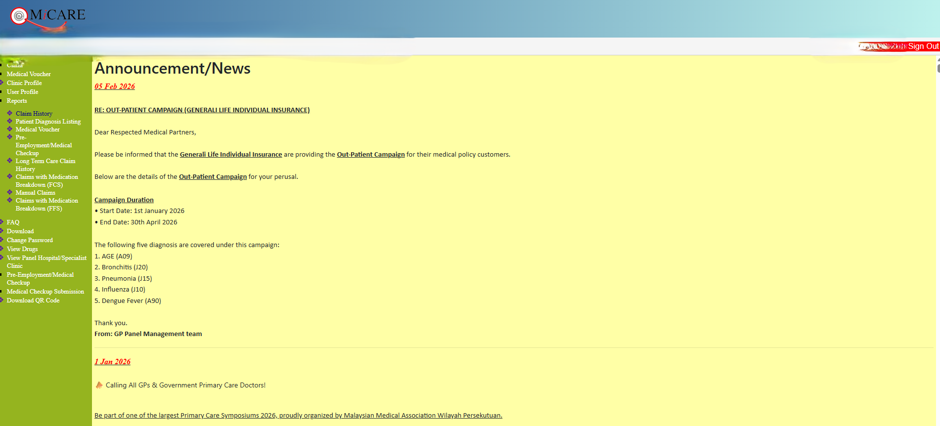
Reports Claim History
Next, go to Reports
Then, click on Claim History

Slide 3
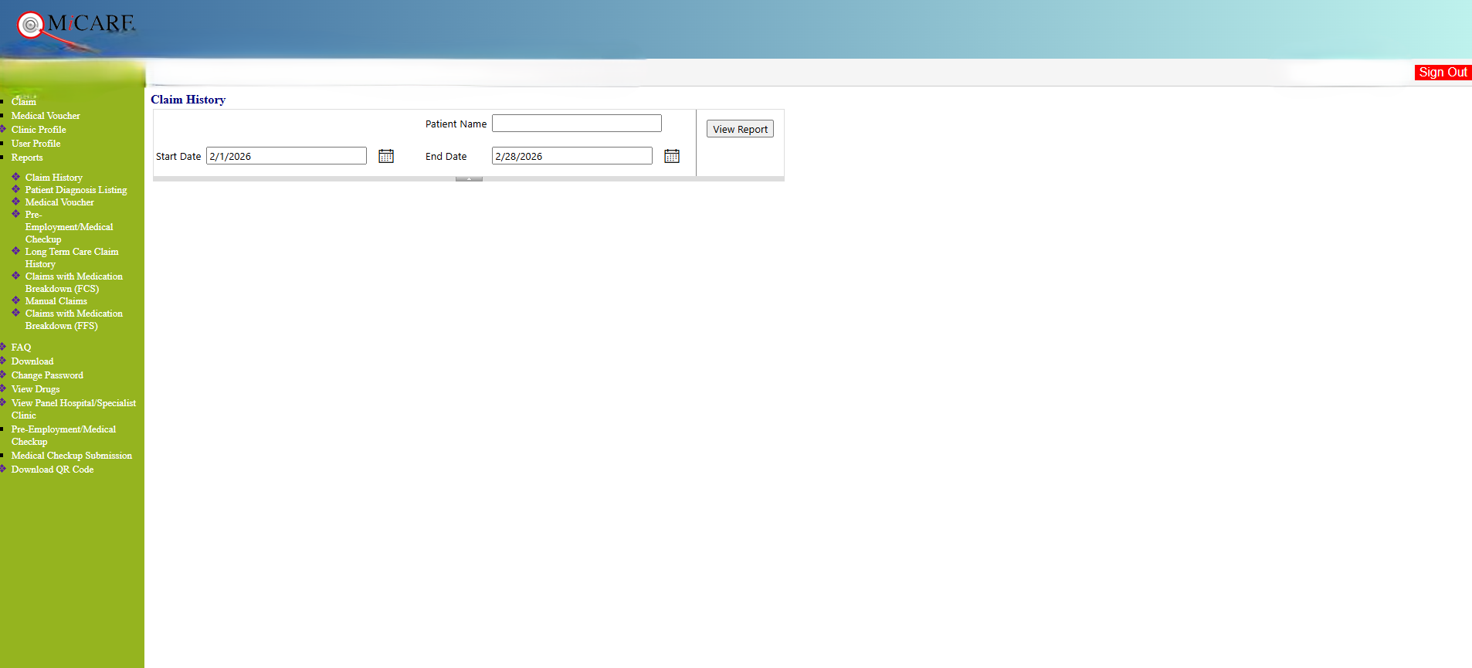
Date
Enter the Start Date and End Date
(Start Date is beginning of the month : eg 1 Feb 2026)
(End Date is end of the month : eg 28 Feb 2026)

Slide 4
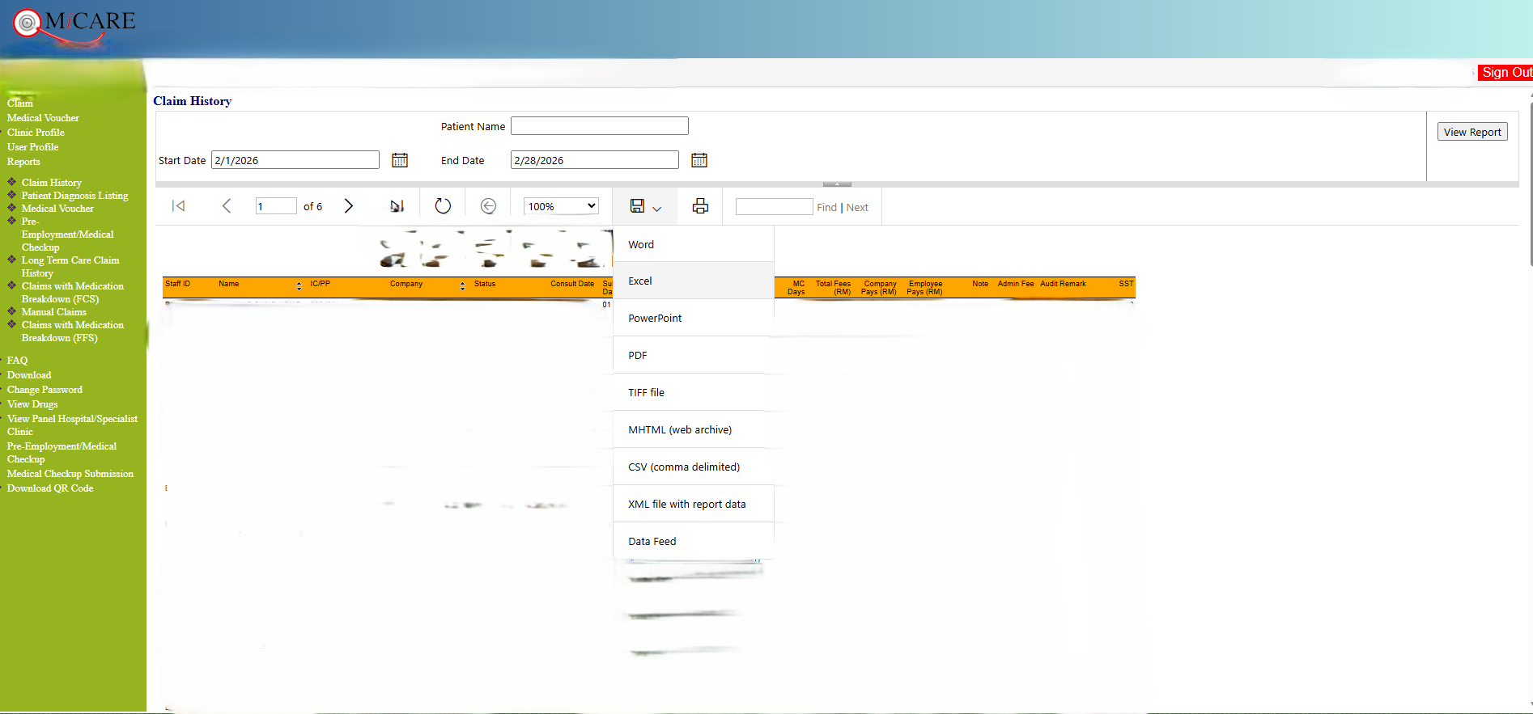
Download
Next, click on Save button, choosing Excel

