Slide 1

Login
Login to PMCare

Slide 2
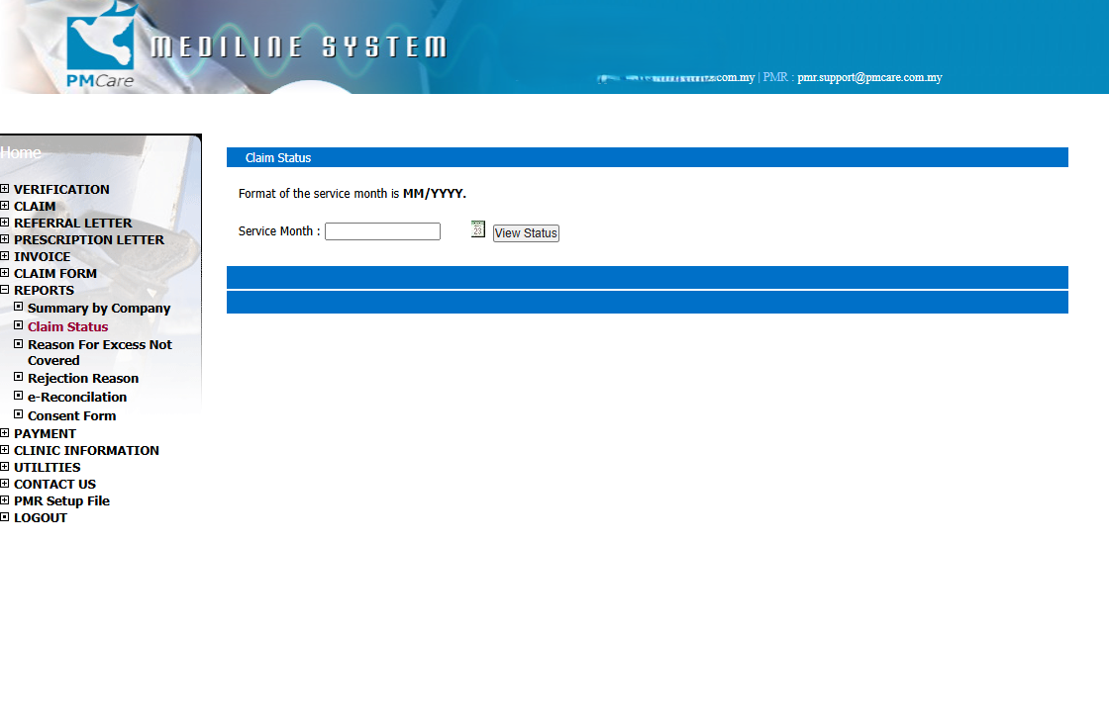
Reports and Claim Status
Click on Reports
Click on Claim Status

Slide 3
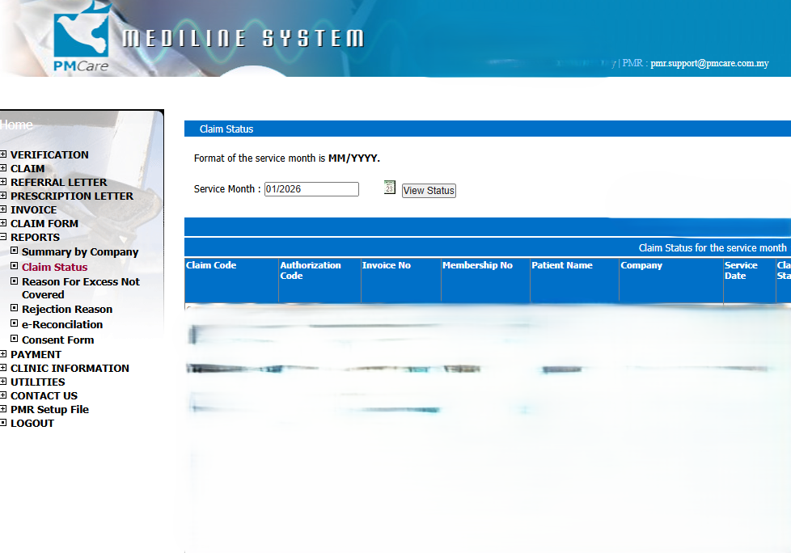
Enter Date
Choose whichever date for the wanted month
Click View Status

Slide 4
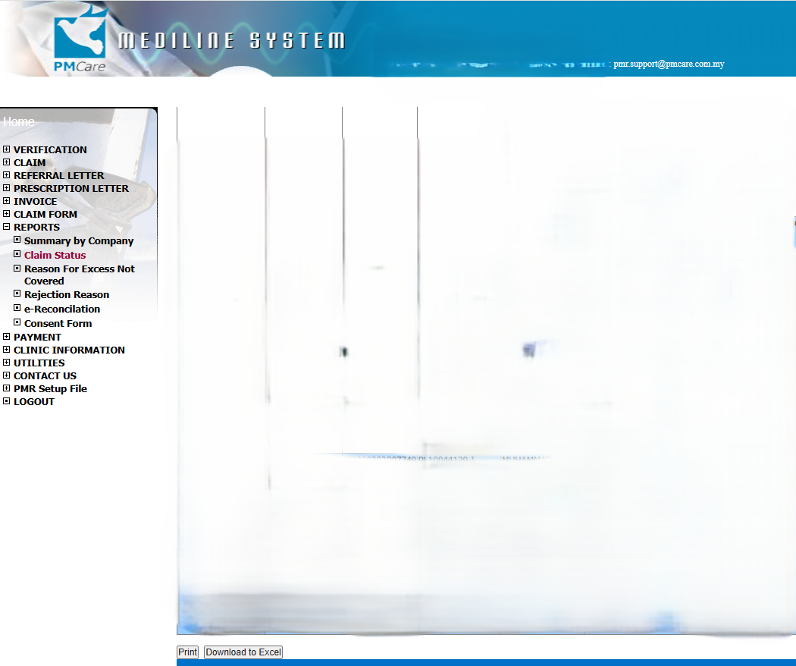
Download
Click Download to Excel at the bottom of the listing
Rename downloaded file to PMCare month year for easy reference (eg : PMCareFeb2026)

