Slide 1
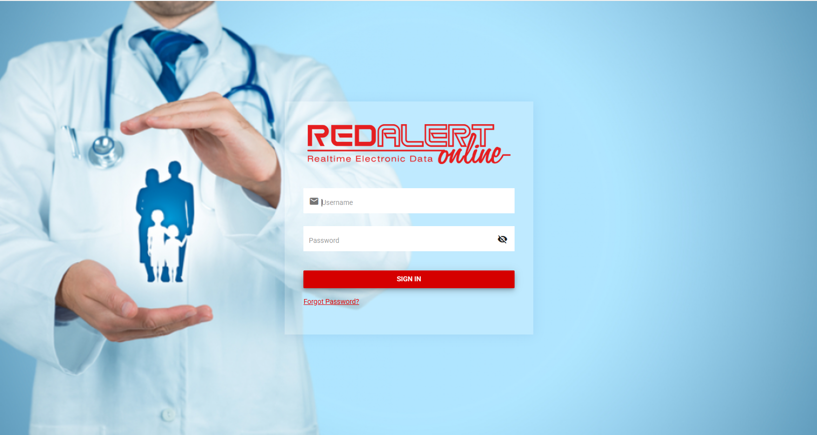
Login
Login to Red Alert Online

Slide 2
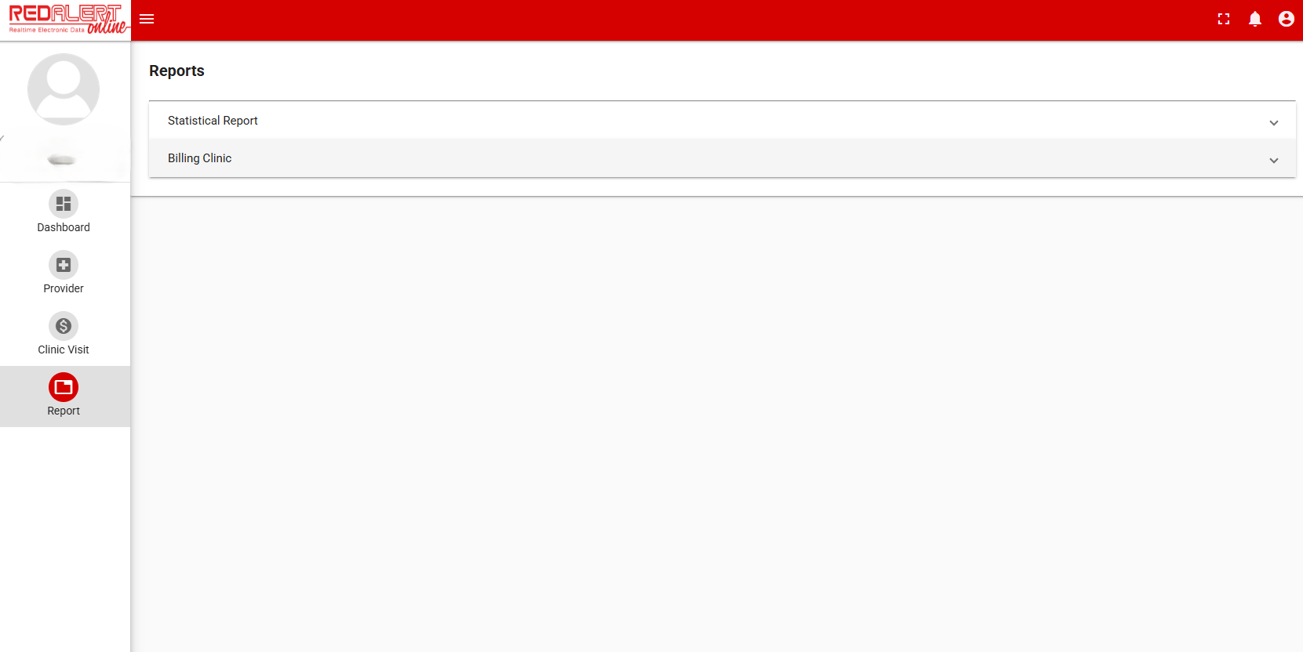
Report
Click on Report
Then Billing Clinic

Slide 3
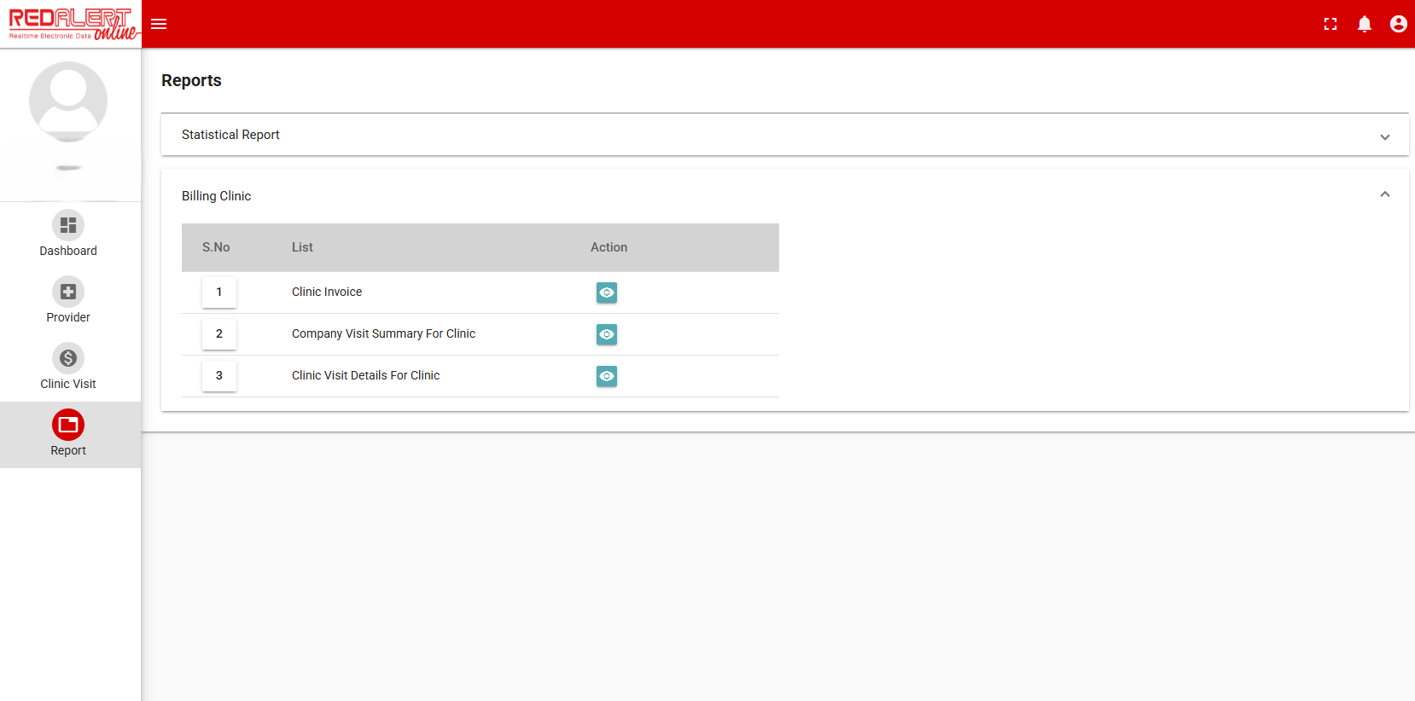
Clinic Invoice
Click on the blue button at Clinic Invoice

Slide 4
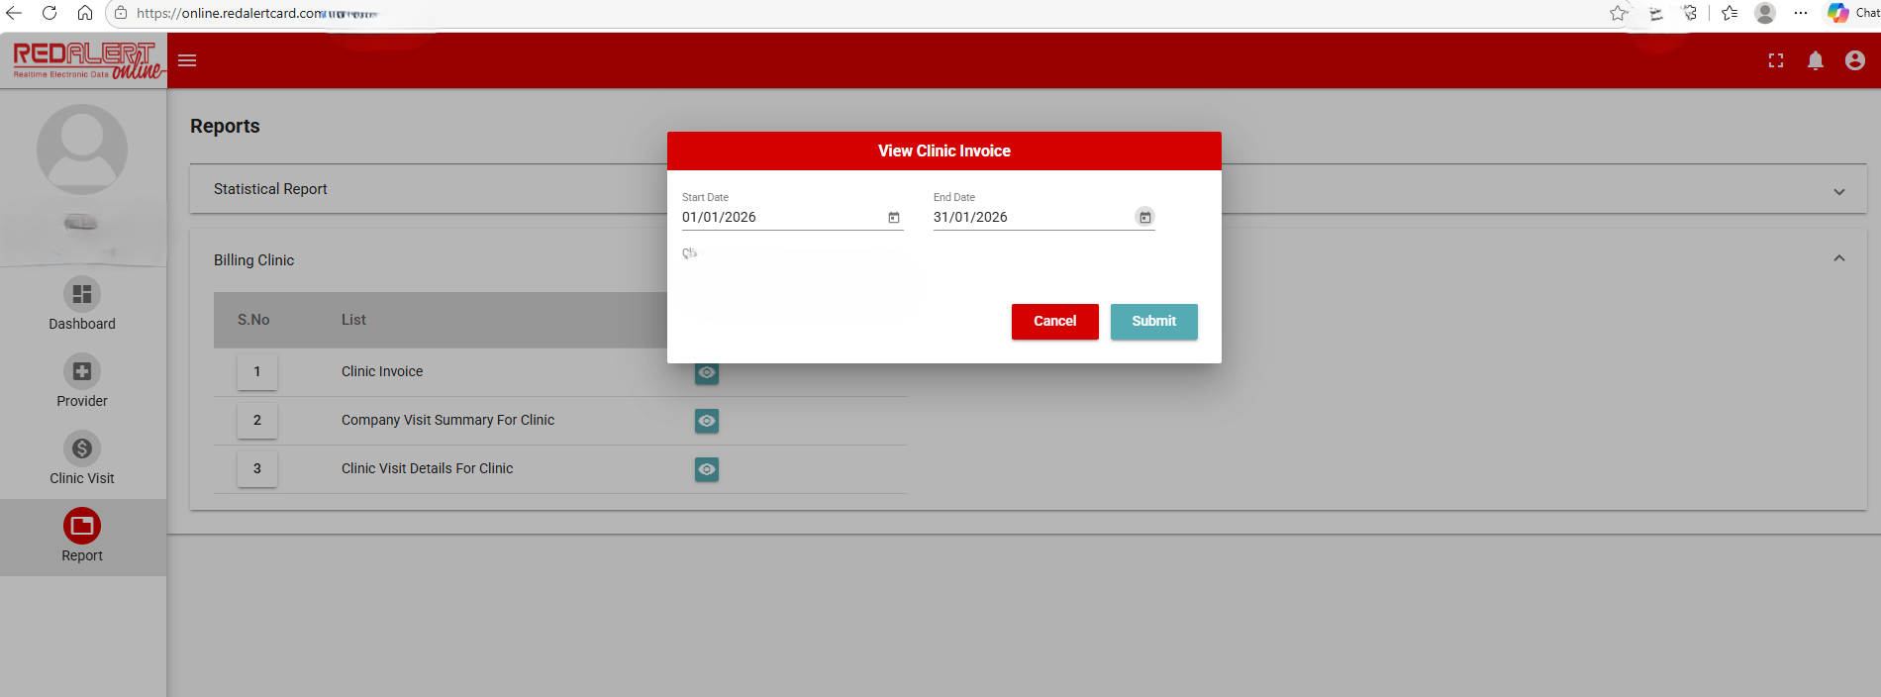
Insert Date
Put in Start Date and End Date
Start Date example : 1st January 2026
End Date example : 31st January 2026
Click Submit

Slide 5
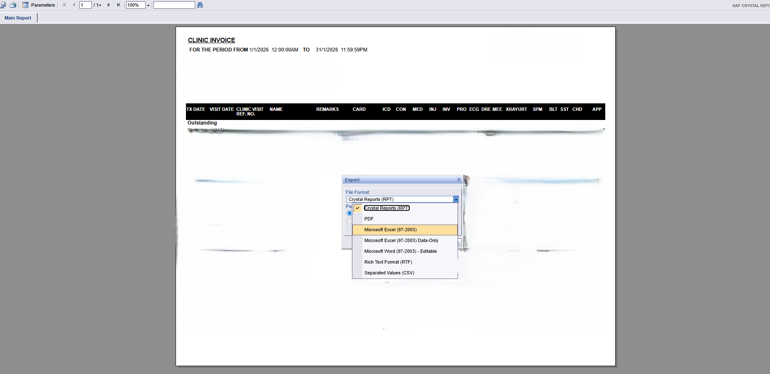
Export
Click the top left button
Click Microsoft Excel (97-2003) to download
Rename downloaded file as RedAlertOnline month year for easy reference (eg : RedAlertOnlineFeb2026)

Slide 6
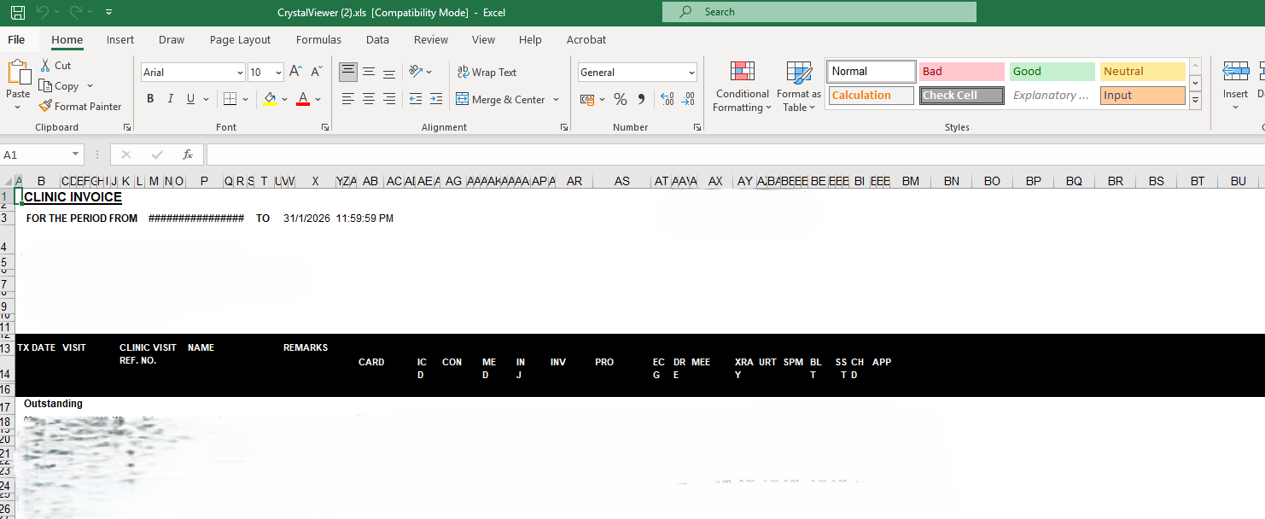
Save .xls into .xlsx
Open the file
Go to File at top left corner

Slide 7
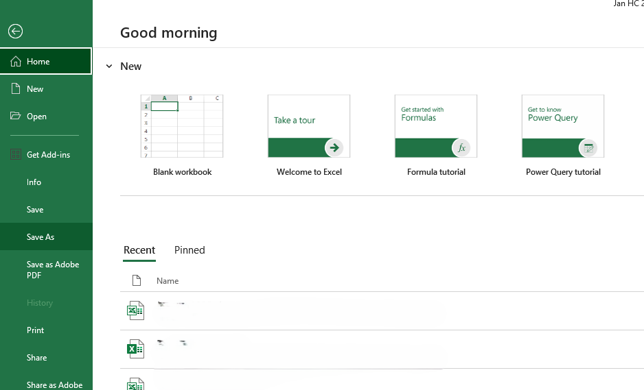
Save as
Click Save As

Slide 8
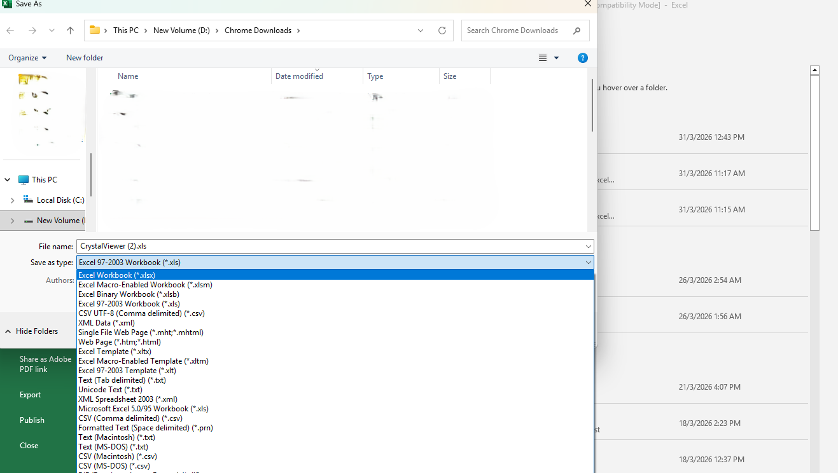
Save as Excel Workbook (*.xlsx)
Save as Excel Workbook (*.xlsx)
Rename downloaded file as RedAlertOnline month year for easy reference (eg : RedAlertOnlineJan2026)

